Slide 1


Improve your Azure productivity Using Visual Studio Code
Eldert Grootenboer

Slide 2


Eldert Grootenboer
@egrootenboer

Slide 3
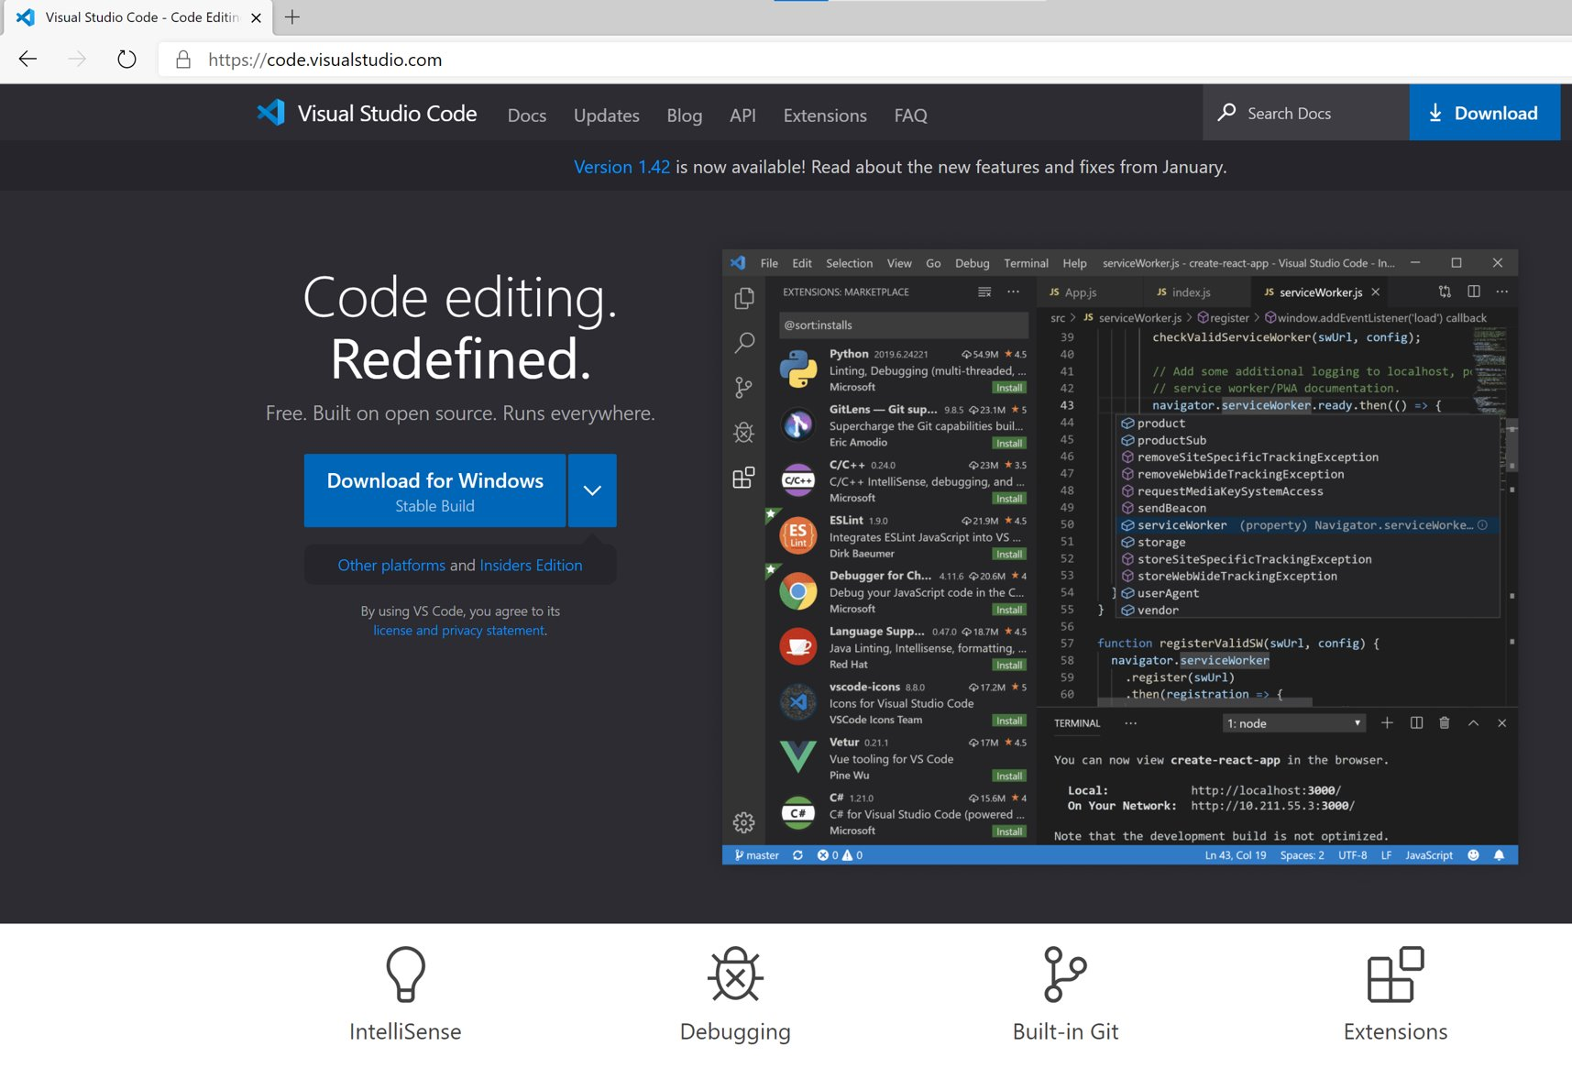
What is Visual Studio Code?

Slide 4
Visual Studio Code & Azure
One tool to rule them all
First class citizen
Adjust to your workflow

Slide 5

Demo time!

Slide 6
Logic Apps
Browse and manage
Create deployment templates
Logic Apps on Functions runtime (preview)
Develop from Visual Studio Code
New editor

Slide 7
API Management
Manage your environment
Extract deployment templates
Test your APIs
REST Client
.vscode settings

Slide 8
Functions
Develop and debug
Manage and monitor
Durable Functions Monitor
Notes:
Durable Functions Monitor - Visual Studio Marketplace

Slide 9
ARM Templates
Intellisense and syntax highlighting
Snippets
Schema and parameter validation
Sorting
Extraxt variables and parameters
ARM Template Viewer

Slide 10
Live Share
Real-time collaboration
Editing and debugging
Including live audio and text chat

Slide 11
GitHub Codespaces
Get started quickly
Same setup anywhere
Work locally or in a browser

Slide 12
Customize to your needs
JSON / XML
GitHub / Azure DevOps
Linting
Draw.io

Slide 13

Almost done…

Slide 14
Recap
Productivity
Extensions
Visual Studio Code ♥ Azure
Notes:
Focus on getting more productivity by using the right tool for the job
Extensions allow to customize to your needs
Use Visual Studio Code when working with Azure

Slide 15



Thank You!
@egrootenboer
eldert@eldert.net
https://www.linkedin.com/in/eldert-grootenboer
Notes:
Rustig spreken!

